Slide 1
Image Reconstruction Algorithms of Positron Emission Tomography (PET)
Zong Fan

Slide 2
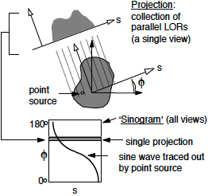
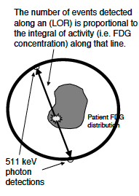
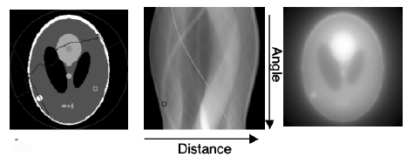
Principle of PET Imaging
Photon detection to form sinograms
Reconstruction from sinograms
Photon detection
Ref: A. Alessio. Introduction to pet image reconstruction. 2007.

Slide 3
Reconstruction Problem & Methods
Reconstruction is a linear inverse problem: Hf=p
Analytic image reconstruction
Direct computing via Fourier transform
Principle: without noise => Hf=p
Fast but low reconstruction accuracy
Iterative image reconstruction
progressive updating towards best solution
Principle: with statistical noise and physical effect => Hf+n=p
Relatively slower but with higher performance
2 key components: evaluation criterion & optimization algorithm

Slide 4
Future Directions
3D reconstruction
using fully 3D PET data instead of slices of 2D
Time-of-flight (TOF) imaging
largely improve image quality
Combination with CT/MRI
multi-modality data to guide noise regularization process
Potential of Deep Learning algorithms
learn mapping function directly from data without prori knowledge

